Slide 1
Investigating Patients with Rare Diseases Using Graph-Based Models
MLMI Praktikum – Mid Presentation
Büşra Nur Zeybek, Tuna Karacan, Kai-Ze Deng
Supervisor: Kamilia Zaripova

Slide 2
Table of Contents
Project Outline
Motivation
Literature Review
Model Overview
Project Progress
Preliminary Results
Requirements
Milestones
Conclusion
Q&A
Notes:
This is the outline of today's presentation, we separate into three parts, first is the project outline, second is the current and future progress, in the end we will give a brief summary

Slide 3
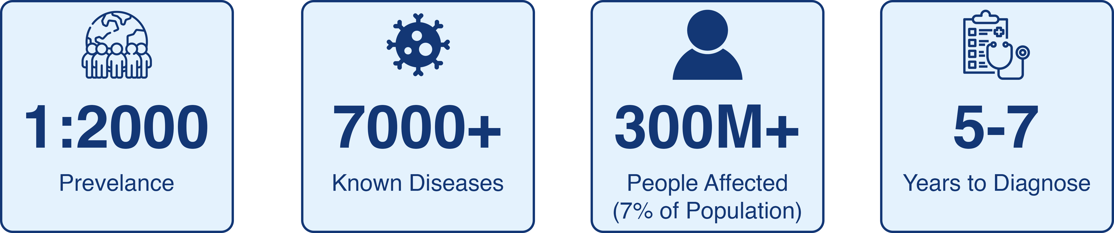
Motivation
Introduction to Rare Diseases:
Notes:
Let's begin, first we want to introduce what is rare diseases and why denoising them is so difficult and time consuming.
Image, you wake up one day with a fever, sore throat, you know immediately you may have seasonal flu, then you go to a doctor and the doctor immediately diagnosis as a flu based on the classical symptoms, then you get medicine, go back to home and take a rest, within a few day, you are recovered.
This is the how the diagnosis of a common diseases typically work – symptoms have clear patterns, the diseases are well-studied, the processes are quick.
Now image, Emma, she started showing symptoms when she was 4 years old. Her symptoms were puzzling: unexpected headache, and developmental delays. Her parents took her to variety of tests, her local doctors were still helpless to do anything about it, because Emma's symptoms are beyond the knowledge of the doctors and don't fit any common pattern.
This is the reality of rare disease, every pattern is so unique, cases are so rare, that most of doctors never see during their career.
So, let's first define what are rare diseases, from the european commission on public health, rare diseases are life-threatening or long-term disabling, which affect …..
This may seem like not many people, but in fact, there are >7000 known rare diseases and affecting 300 miliion(7% of population worldwide), and It takes average 5-7 years to diagnosis a rare disease.

Slide 4
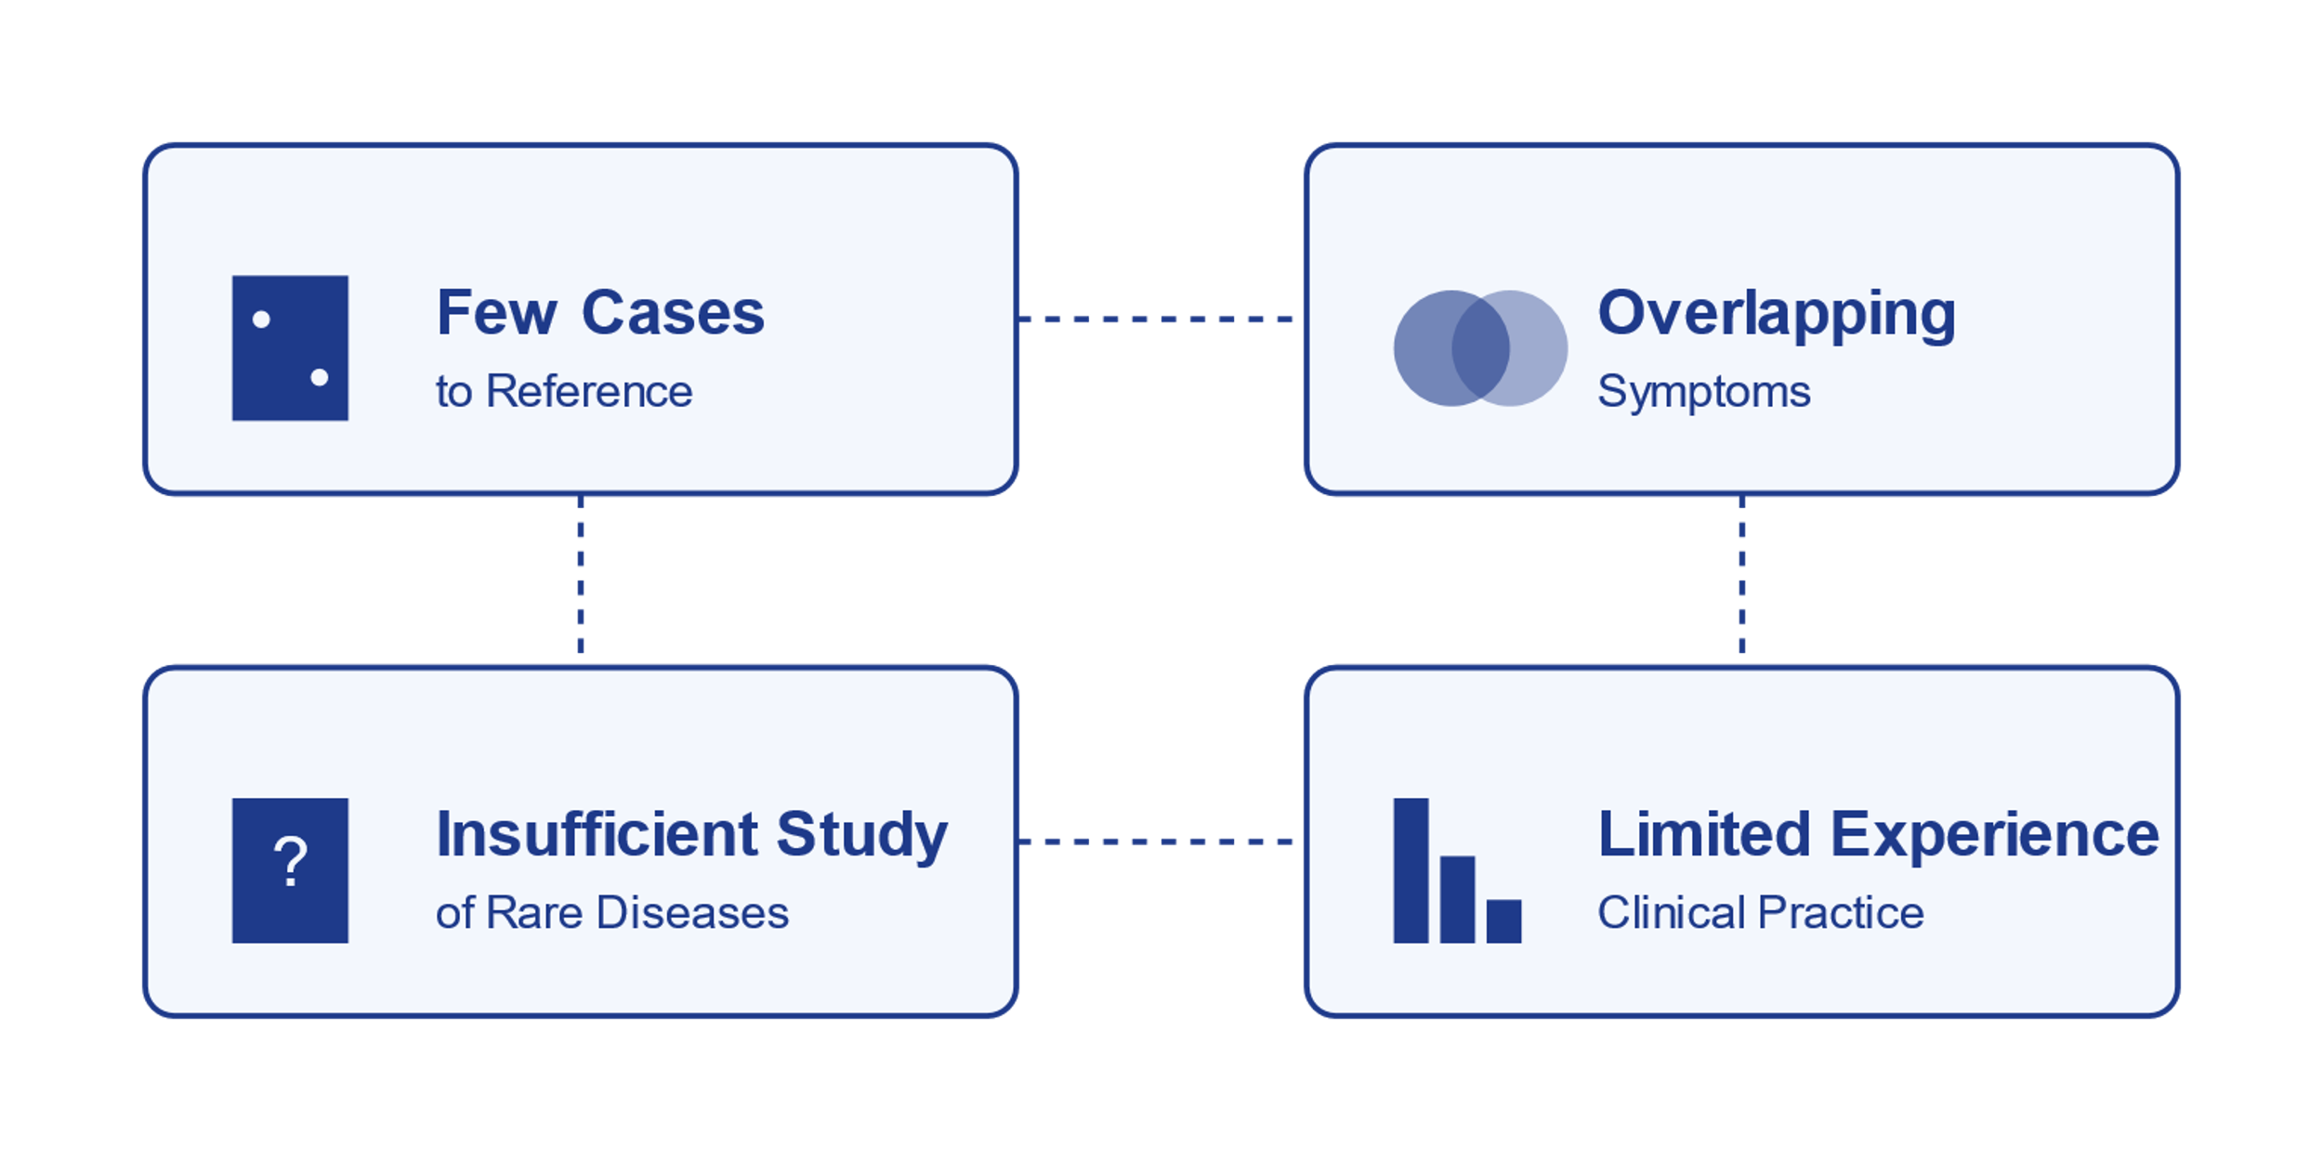
Motivation
Current Challenges of Diagnosing Rare Diseases:
Notes:
So, why are diagnosing so difficult.
First, the cases are few and sparse all over the world, it is hard for doctors to refer the cases when diagnosing.
Second, the symptoms of rare diseases may be different from patient to patient and often overlap with some common diseases, for example, a rare metabolic disease represents with headache has similar symptom with a simpler case like stress. This makes even harder for doctor because it lead easily to mis-diagnosis.
Third, due to the number of patients, the investigation into rare disease is always not enough.
Fourth, most of doctor may see only two or three cases among thir entire career. They simply don't have knowledge and experience about it.

Slide 5
Motivation
Our Approach: Using Graph-Based Model Learning
Represents relations between diseases, genes and phenotypes
Handle various of data sources
Notes:
Now, let me explain why we believe graph-based AI can make a real difference in rare disease diagnosis.
First, a quick overview of graph neural network, first there are two elements in Graph, node and edge, nodes represent the entities or other elements in a graph and the edge represent the relationships or connections between the nodes.
graph-based learning allows us to represent complex relationships between diseases, genes, and phenotypes in a way how they actually interact in the human body. Also, it can comines variabity of data from different sources, likes genes, phenotypes, clinical records.

Slide 6
Motivation
Why the Project Matters:
Discovering Previously Unknown Disease Patterns
Reducing time to diagnosis
Combining the known knowledge to guide the learning process
Finding potential patients with the same causal gene or disease
Notes:
Why do we believe graph- based model will help with the problems.
With our model, we are able to dis......, we will explain how our project discover unknow pattern later.
Our project can provide doctors with hidden connection they didn't notice before to help them diagnosing faster
With the GNN structure, it is possible combines the known medical knowledge to guide learning process, it will help with the few data limitation.
With the result, the model provides the connection between similar patients. It will help with identifying similar patients.

Slide 7
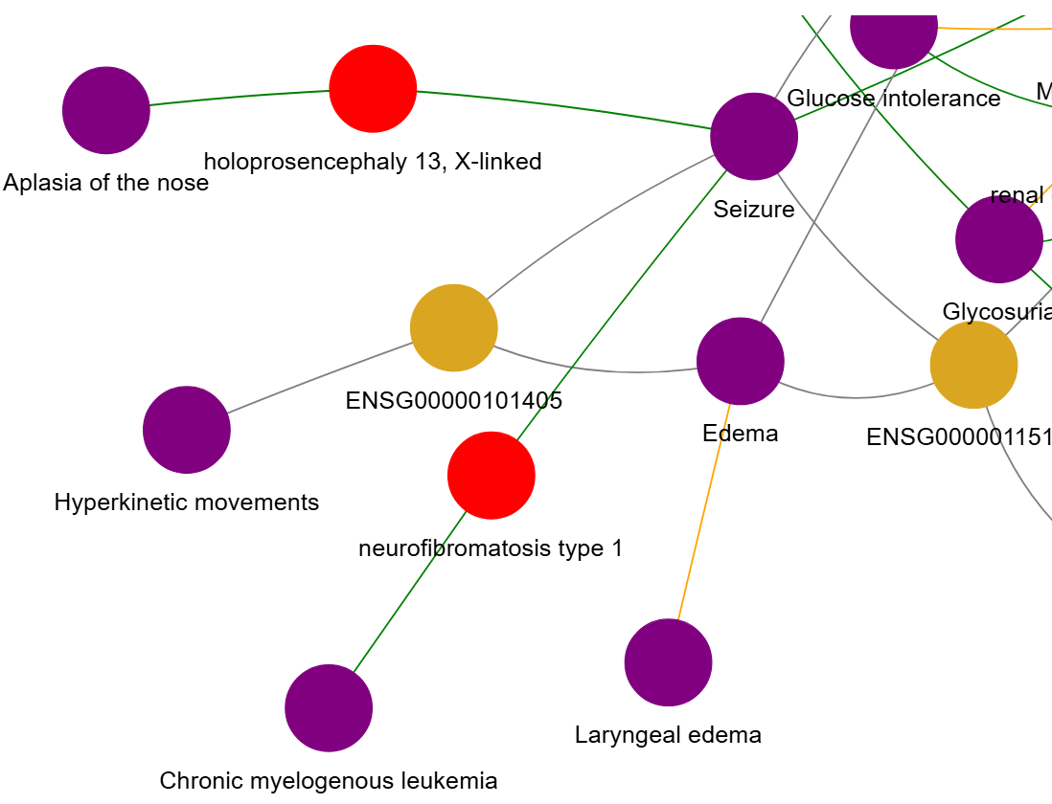
Literature Review
Main Reference: Shepherd Dataset
Provides Dataset for training model
Disease
Effect/Phenotype
Gene/Protein
Alsentzer, E., Li, M. M., Kobren, S. N., Noori, A., Undiagnosed Diseases Network, Kohane, I. S., & Zitnik, M. (2023). Few-shot learning for
phenotype-driven diagnosis of rare genetic diseases.
https://www.nature.com/articles/s41591-023-02504-3
Notes:
We use the dataset from this paper, we will introduce the dataset in the requirment part later.
Simulated populaiton, we will explain the dataset in the rquirement part

Slide 8
Model Overview
Knowledge Graph
A known database of existing medical knowledge
Graph-based representation of medical relationships
Contain established relationships between
Phenotypes
Genes
Diseases
Guides the graph learning process in population-level module
existing knowledge of diseases, phenotypes, and genes
Notes:
We are going to introduce our model elements, first is the knowledge graph, knowledge graph is a graph represents known medical connections, it has three elements like phenotypes, genes diseases....
It is a pre-defined graph, not from our learning process.

Slide 9
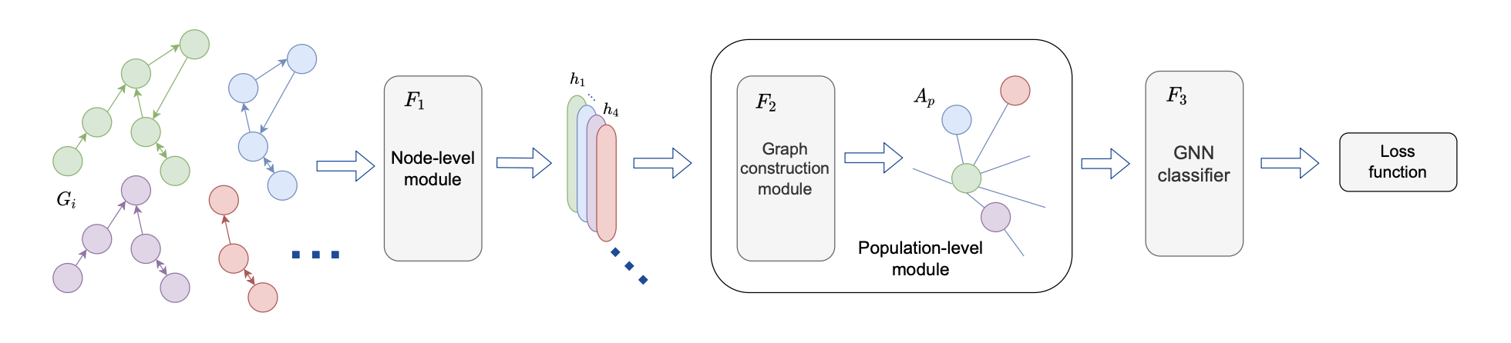
Literature Review
Main Reference:
Graph-in-Graph (GiG): Learning interpretable latent graphs for biological and healthcare applications. (Mullakaeva, K., Navab, N., & Bronstein, M.M.,2023)
Designed to learn interpretable latent graphs from multi-scale data.
Hierarchical structure to extract insights at both node-level and population-level.
Mullakaeva, K., Navab, N., & Bronstein, M.M (2023). Graph-in-Graph (GiG): Learning interpretable latent graphs in non-Euclidean domain for biological and healthcare applications

Slide 10
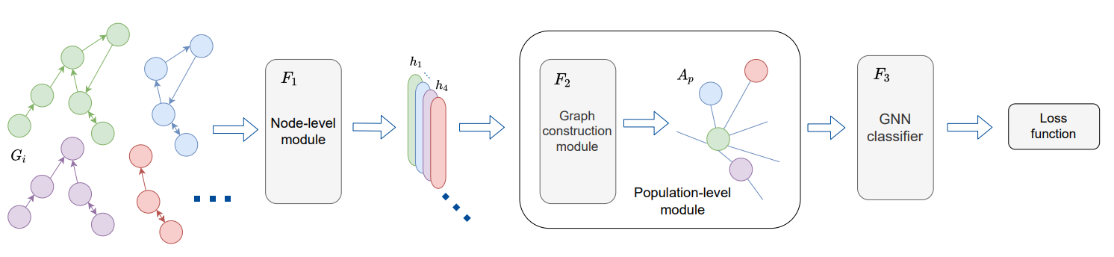
Model Overview
Node-Level Module:
Processes input patient sub-graphs
Population-Level Module:
Learns a latent graph connecting all input graphs.
Classifier Module:
Combines outputs for downstream tasks

Slide 11
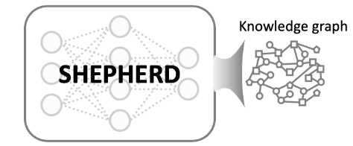
Model Overview
Node-Level Module - F1:
Extract structural information of individual patient.
Input: Extracted subgraphs from Knowledge Graph
Node: features of individual patient (phenotypes, genes, diseases)
Edge: connections between these features
Output: Graph representations
Extract
N patient subgraphs

Slide 12
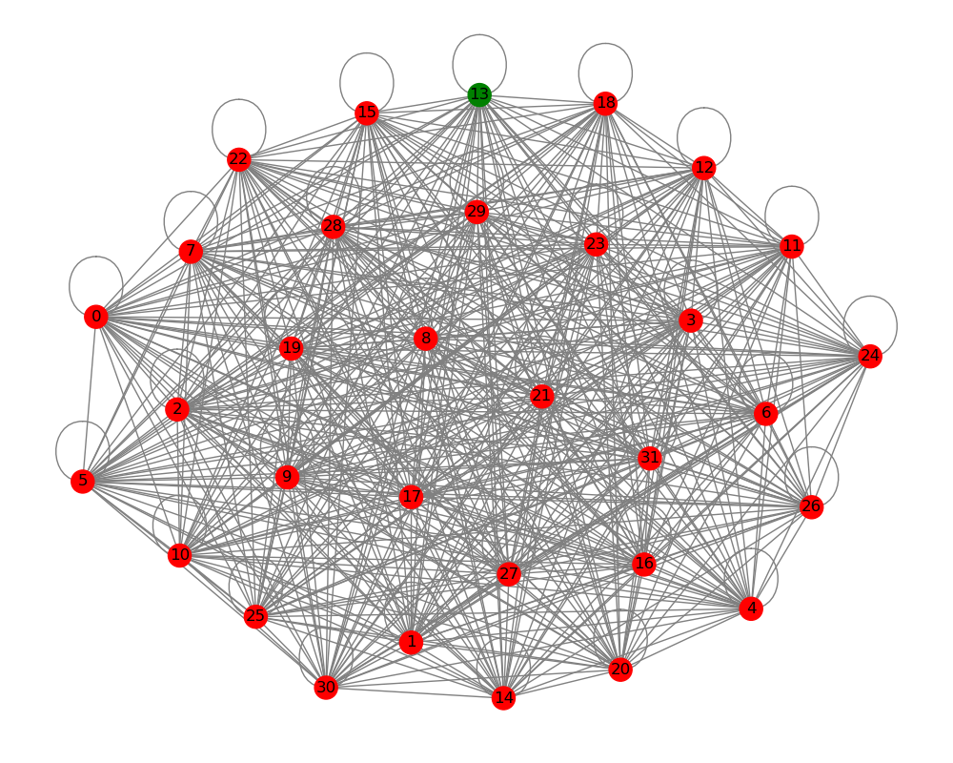
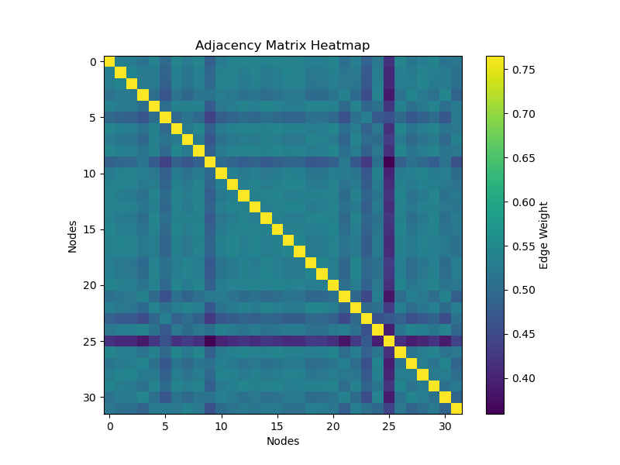
Model Overview
Population-Level Module - F2:
Discovers connections between patients
Input: Graph embeddings from F1
Output: adjacency matrix that represents the similarities between patients
Node: individual patient
Edge: Similarities between patients

Slide 13
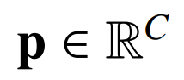
Model Overview
Classifier Module – F3:
Predicts downstream tasks like causative gene prediction, disease classification or risk prediction.
Inputs: Graph embeddings and latent graph from F1 and F2
Output: Predictions (y_pred) size [N, C]
Class probability vector

Slide 14
Preliminary Results
No knowledge discovery yet
Key observations:
Diagonal elements: self loops
Nondiagonal elements: connections between patients -> potential communities
Only 1 correct prediction of true gene
Initial model struggles to learn effectively
Predictect correctly
Misclassified

Slide 15
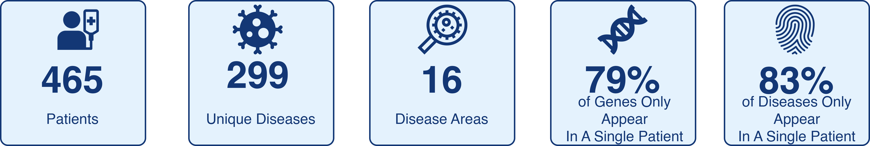
Requirement
Dataset:
Training dataset: Patients

Slide 16
Milestones & Timeline

Slide 17
Conclusion
Reality: Rare diseases are reality of our world.
Goal: Our goal is to help medical professionals diagnose and give treatment better.
Method: We propose a method to discover hidden knowledge using GiG framework.
Findings: Initial findings show model parameters need significant improvement.
Future: Next steps are improving, fine-tuning and testing.

Slide 18
Q&A
Thank you for your attention, do you have any questions?

Slide 19
Technical Details
config = {
"node_level_module": "GIN",
"num_node_features": 7,
"node_layers": [32, 16],
"node_level_hidden_layers_number": len([32, 16]), # Number of hidden layers
"pooling": "mean",
"population_level_module": "LGL",
"population_layers": [16, 8],
"temp": 0.5,
"theta": 0.1,
"gnn_type": "GraphConv",
"gnn_layers": [8],
"gnn_aggr": "mean",
"classifier_layers": [8],
"output_dim": 2405,
}

Slide 20
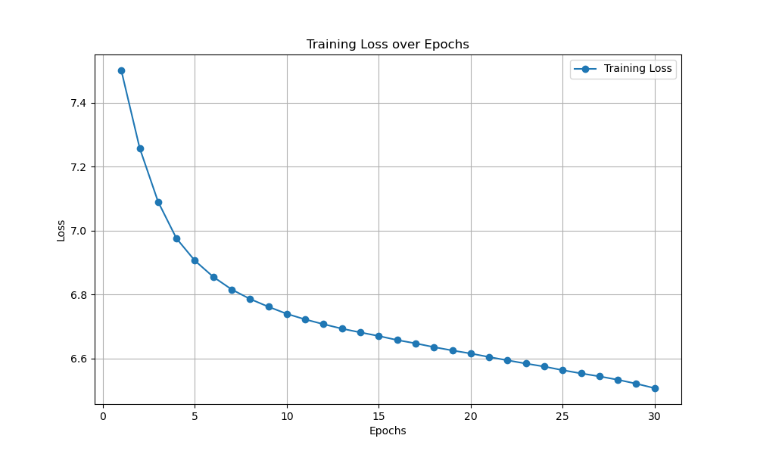
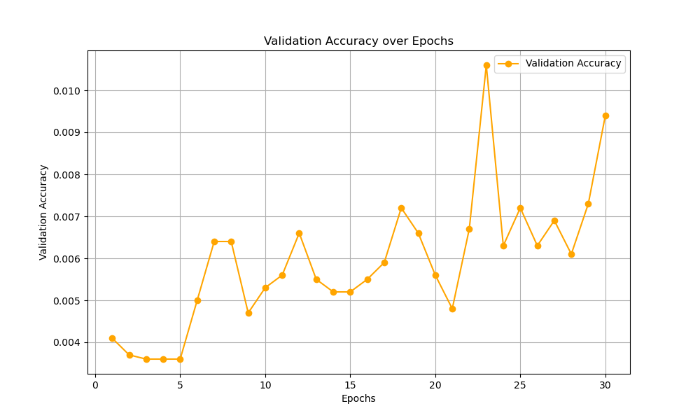
Loss/Acc

Slide 21
Notes:
The population level graph is connected patient to patient, the connection is learned purely by patient data, with the help me knowledge graph , it can modify and adjust the weighted connection. Like a regularization term

